Slide 1
Problems - Week 3
Circuit Variables
Circuit Elements
Simple Resistive Circuits

Slide 2
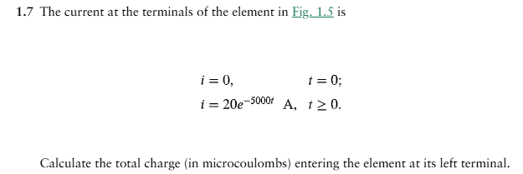
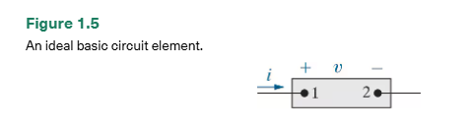
Circuit Variables

Slide 3
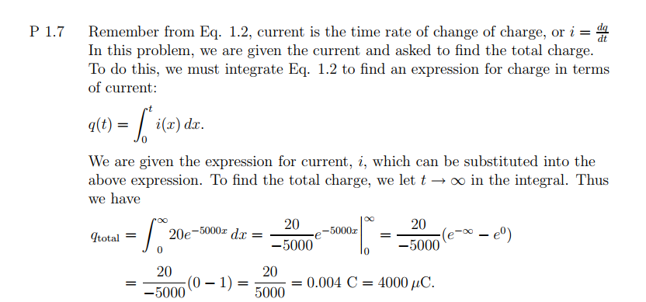
Circuit Variables

Slide 4
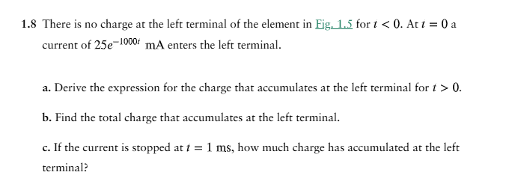
Circuit Variables

Slide 5
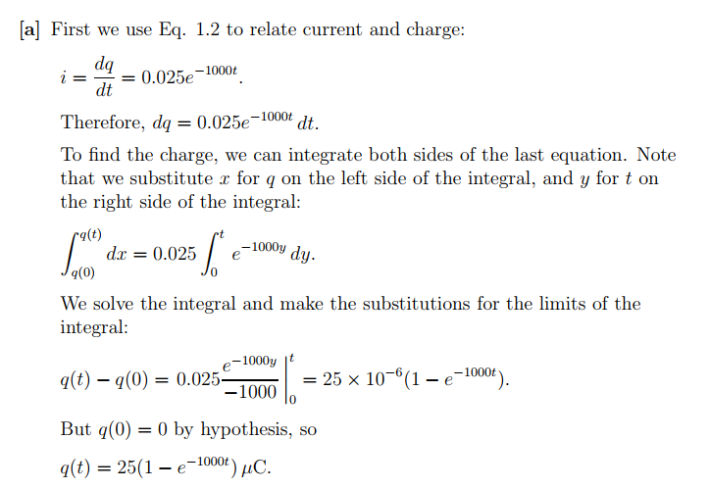
Circuit Variables

Slide 6

Circuit Variables

Slide 7
Circuit Variables

Slide 8
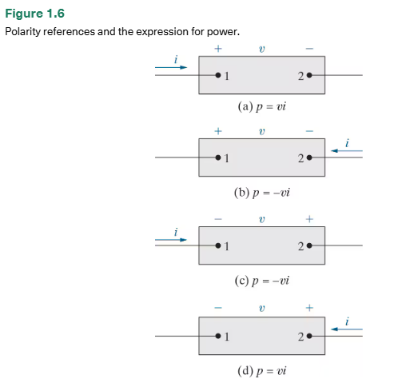
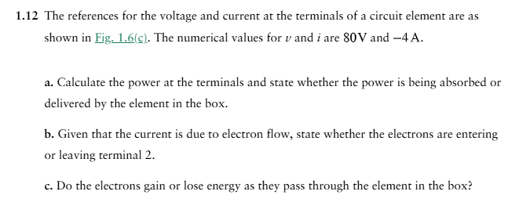
Circuit Variables

Slide 9
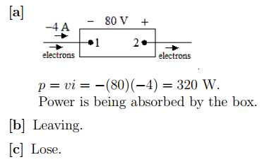
Circuit Variables

Slide 10

Circuit Variables

Slide 11
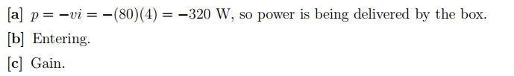
Circuit Variables

Slide 12
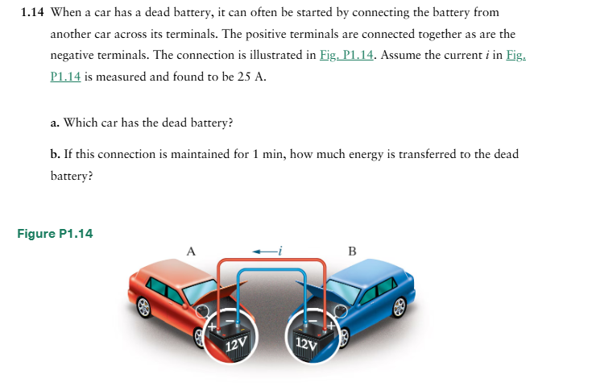
Circuit Variables

Slide 13
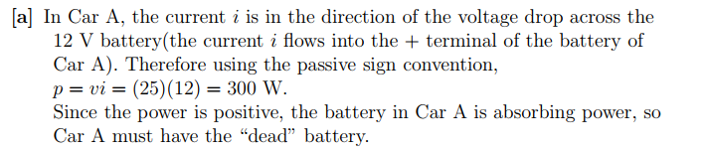
Circuit Variables

Slide 14
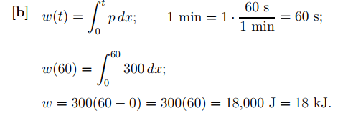
Circuit Variables

Slide 15
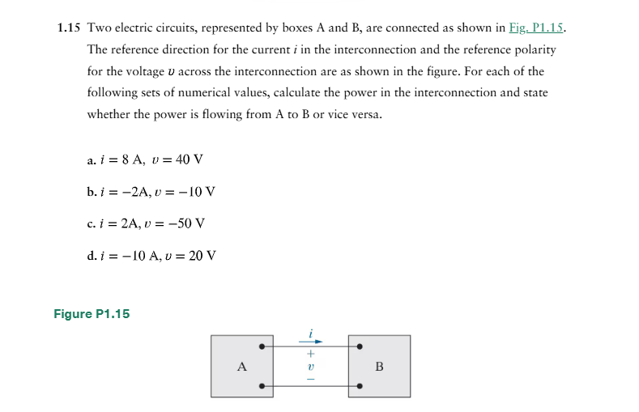
Circuit Variables

Slide 16
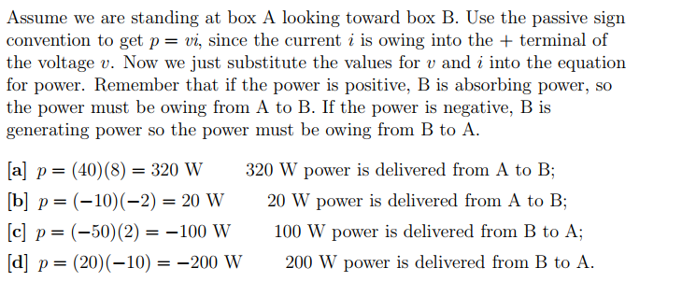
Circuit Variables

Slide 17
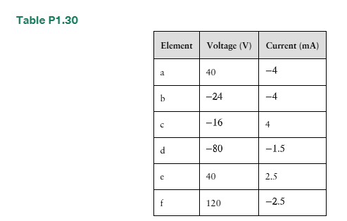
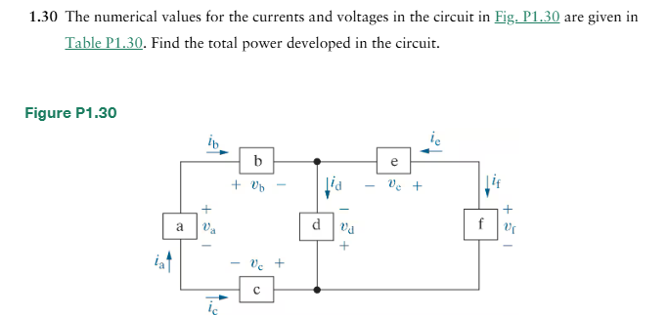
Circuit Variables

Slide 18
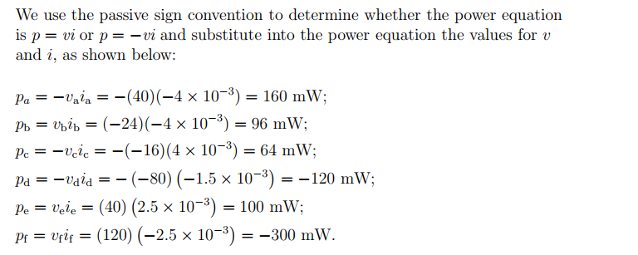
Circuit Variables

Slide 19
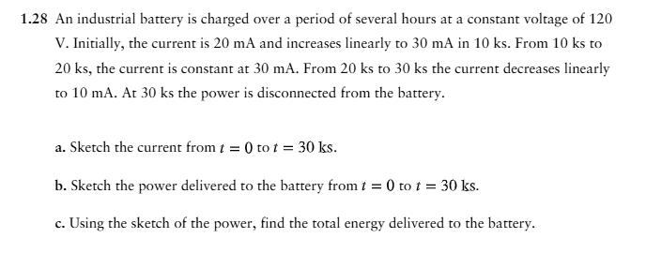
Circuit Variables

Slide 20
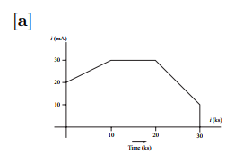
Circuit Variables

Slide 21
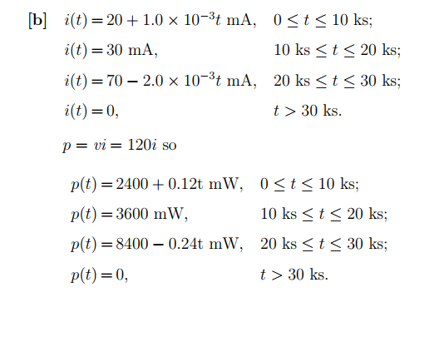
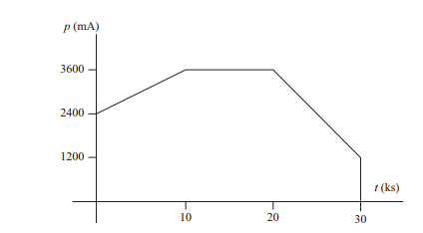
Circuit Variables

Slide 22
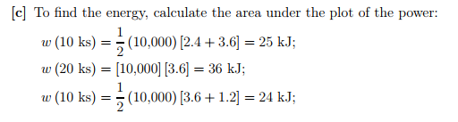
Circuit Variables

Slide 23
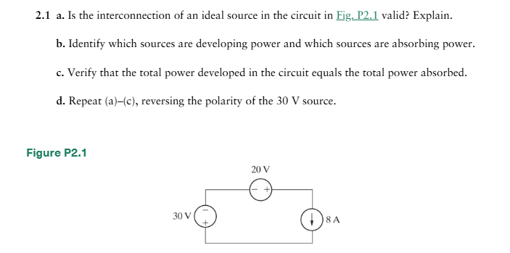
Circuit Elements

Slide 24
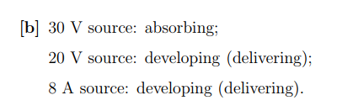
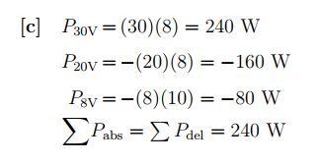
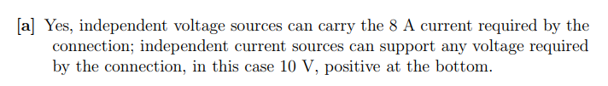
Circuit Elements

Slide 25
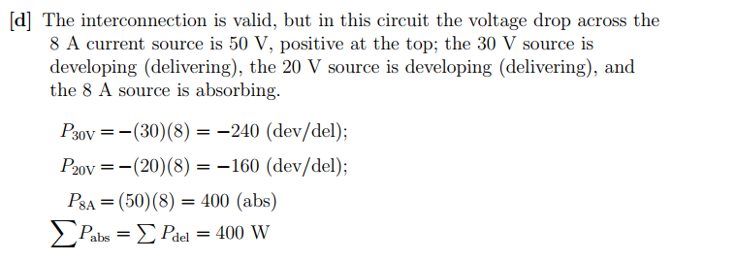
Circuit Elements

Slide 26
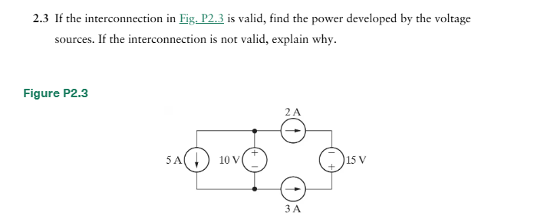
Circuit Elements

Slide 27

Circuit Elements

Slide 28
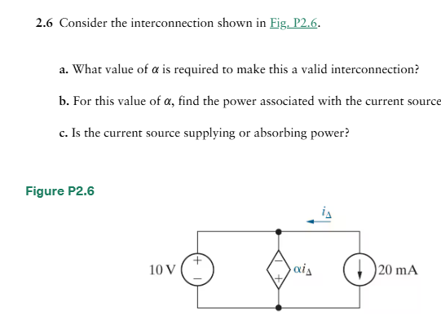
Circuit Elements

Slide 29
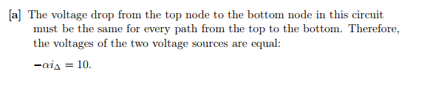
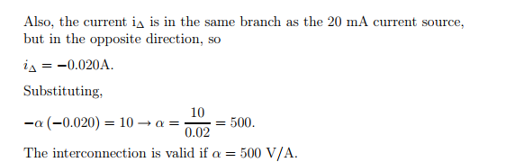
Circuit Elements

Slide 30
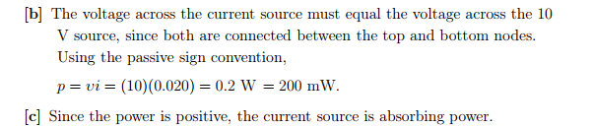
Circuit Elements

Slide 31
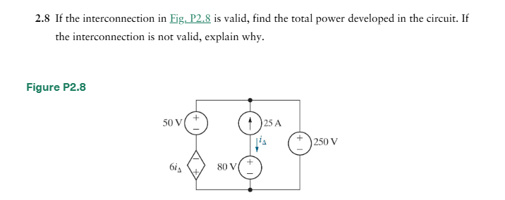
Circuit Elements

Slide 32
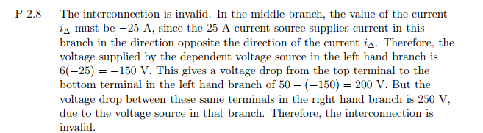
Circuit Elements

Slide 33
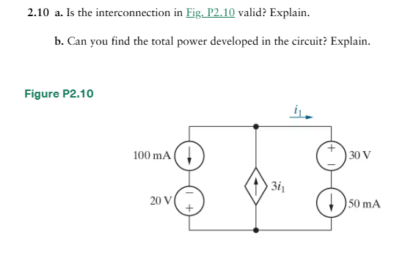
Circuit Elements

Slide 34
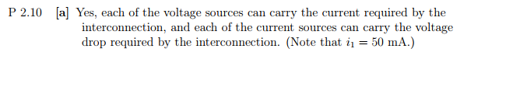
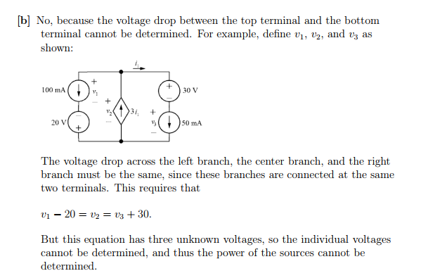
Circuit Elements

Slide 35
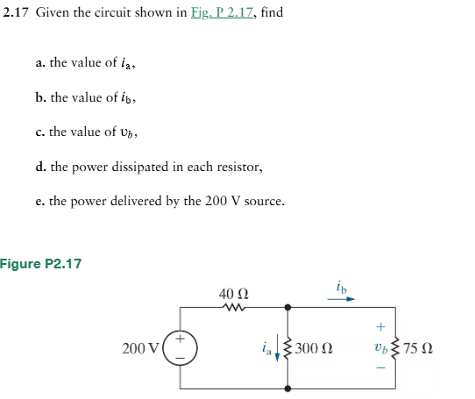
Circuit Elements

Slide 36
Circuit Elements

Slide 37
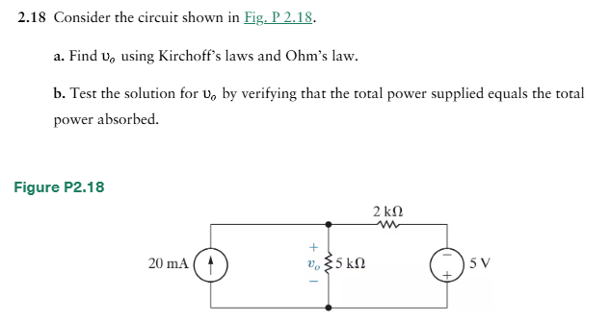
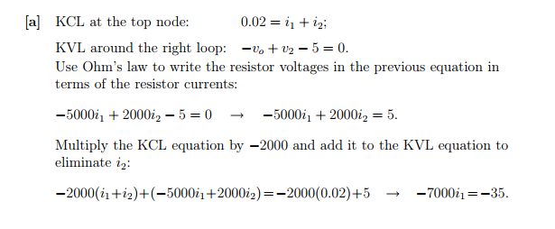
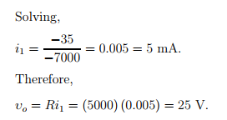
Circuit Elements

Slide 38
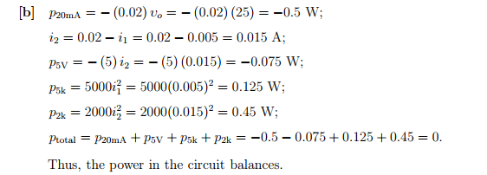
Circuit Elements

Slide 39
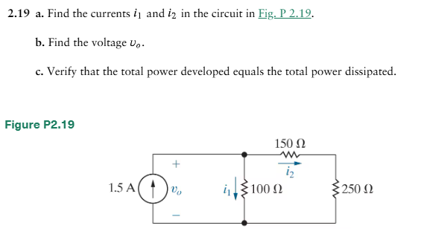
Circuit Elements

Slide 40
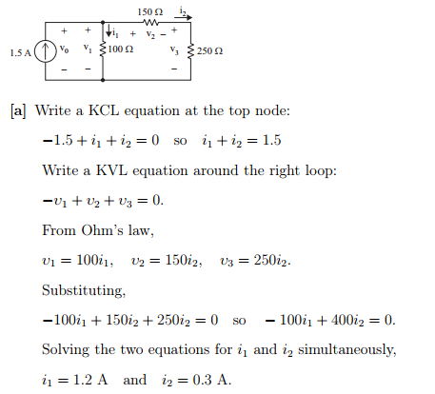
Circuit Elements

Slide 41
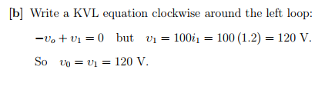
Circuit Elements

Slide 42
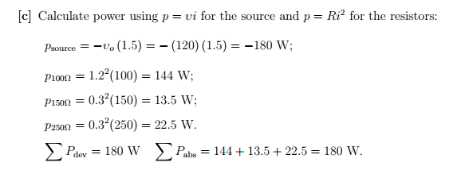
Circuit Elements

Slide 43
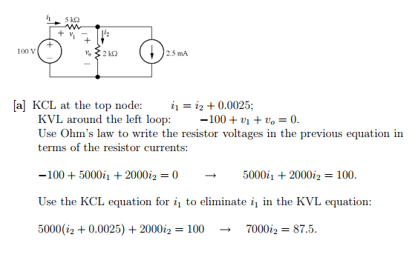
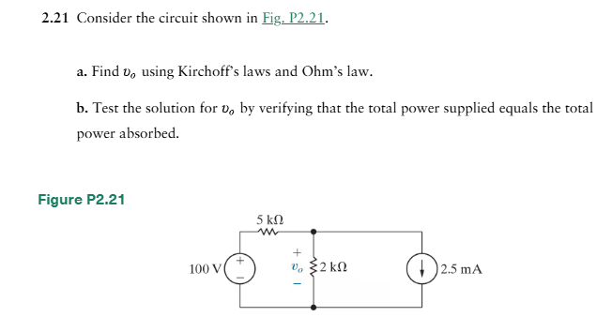
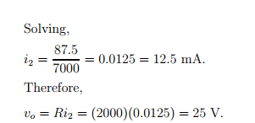
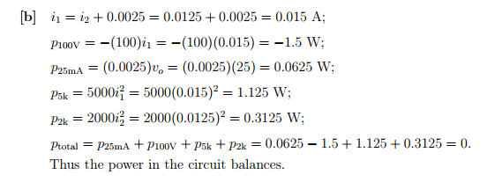
Circuit Elements

Slide 44

Circuit Elements

Slide 45


Circuit Elements

Slide 46


Circuit Elements

Slide 47

Circuit Elements

Slide 48



Circuit Elements

Slide 49

Circuit Elements

Slide 50

Circuit Elements

Slide 51

Circuit Elements

Slide 52

Circuit Elements

Slide 53

Circuit Elements

Slide 54

Circuit Elements

Slide 55



Circuit Elements

Slide 56

Circuit Elements

Slide 57

Circuit Elements

Slide 58

Circuit Elements

Slide 59

Circuit Elements

Slide 60

Circuit Elements

Slide 61


Circuit Elements

Slide 62

Circuit Elements

Slide 63

Circuit Elements

Slide 64


Simple Resistive Circuits

Slide 65



Simple Resistive Circuits

Slide 66

Simple Resistive Circuits

Slide 67


Simple Resistive Circuits

Slide 68


Simple Resistive Circuits

